Slide 1

Customer Attrition Analysis
Distributed & Scalable Data Engineering
DSCI 6007
Github Link
Team 5

Slide 2




Team Leader
Data Scientist
Team Leader
Data Engineer
Team
Members
Data Scientist
Data Modeling
Data Modeling
Data Engineer

Slide 3
Objective:
The objective is to utilize the Telco Customer Churn dataset to understand and predict customer churn, identifying key factors and trends that lead to customer disengagement. This insight aims to inform targeted interventions, enhance customer satisfaction, and ultimately reduce churn rates, thereby increasing overall customer lifetime value.

Slide 4
Business Question 1
Which customers are likely to churn based on their usage of services and monthly charges?

Slide 5
Business Question 2
Which customers with no online security or tech support have churned, indicating potential churn risk for similar profiles?

Slide 6
Business Question 3
Predict potential churners by identifying patterns in customers who have discontinued their services.

Slide 7

CRISP - DM
Data Understanding
Data Preparation
Business Understanding
Data Modeling
Deployment
Evaluation

Slide 8
Business Understanding:
Customer Churn data set provides an enhanced narrative for understanding customer behavior in a fictional telecom company. It tracks 7043 customers in California, detailing who has left, stayed, or signed up for services like home phone and internet.
The data includes demographics, satisfaction scores, churn scores, and CLTV indices. Various assets like dashboards, stories, reports, and explorations offer insights into factors affecting churn, aiming to inform strategies for improving customer retention and value.

Slide 9
Data Understanding:
Customer churn data involves recognizing the dataset's structure and content. It encompasses 7043 records detailing customer interactions with a fictional telecom company, including demographics, service subscriptions, and financial metrics like monthly charges and CLTV.
The dataset tracks customer outcomes (churn) and provides a foundation for analyzing factors influencing retention.
This comprehensive view aids in identifying trends, patterns, and potential areas for action to enhance customer satisfaction and reduce churn rates.

Slide 10
Data Preparation:
Consolidating and cleaning data from various sources, such as demographics, service subscriptions, and location details. This step includes merging datasets, handling missing values, encoding categorical variables, and ensuring consistency across records. The goal is to create a unified, clean dataset ready for analysis and modeling to uncover insights into customer churn patterns.

Slide 11
Modeling:
Customer Churn project would involve applying statistical or machine learning algorithms to the prepared dataset to predict customer churn. This step includes selecting appropriate models (like logistic regression, decision trees, or neural networks), training the models on a portion of the data, and validating their performance using another portion.
The goal is to identify the model that best predicts churn based on customer demographics, service details, and other relevant factors, to inform targeted retention strategies.

Slide 12
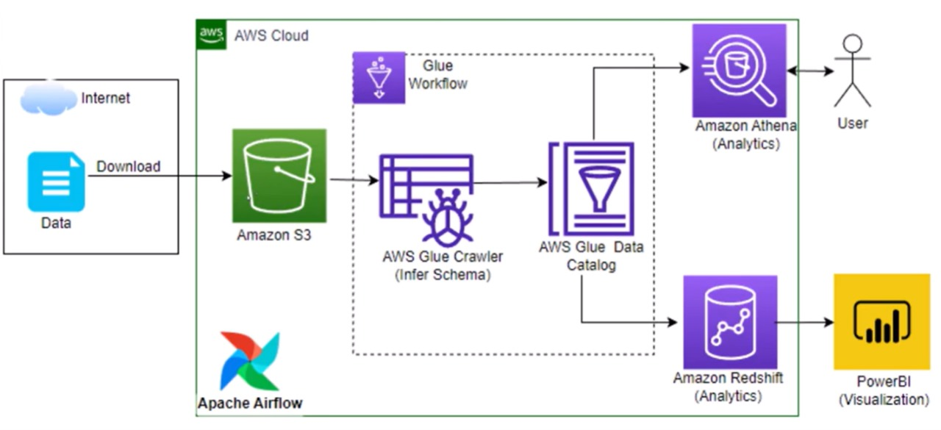

Slide 13
Evaluation:
In the evaluation phase, the performance of predictive models developed during the modeling stage is assessed against a set of predefined metrics. This could include accuracy, precision, recall, F1 score, or ROC-AUC.
The aim is to determine how well the model predicts customer churn and to identify any areas for improvement. This step is crucial for ensuring the model's reliability and effectiveness in addressing the business problem at hand.

Slide 14
Deployment:
The model is deployed using Amazon Web Services (AWS).
Here in deployment phase firstly, we will be loading data into S3 bucket. By using this data, we will be creating crawler in AWS Glue which will helps us for creation of tabular information of required data.
And then loading the crawler into AWS Glue. We will be using the glue in Athena and RedShift here for the Extract, Transform, Load(ETL) process.
Overall ETL process will be held in the Amazon RedShift.

Slide 15
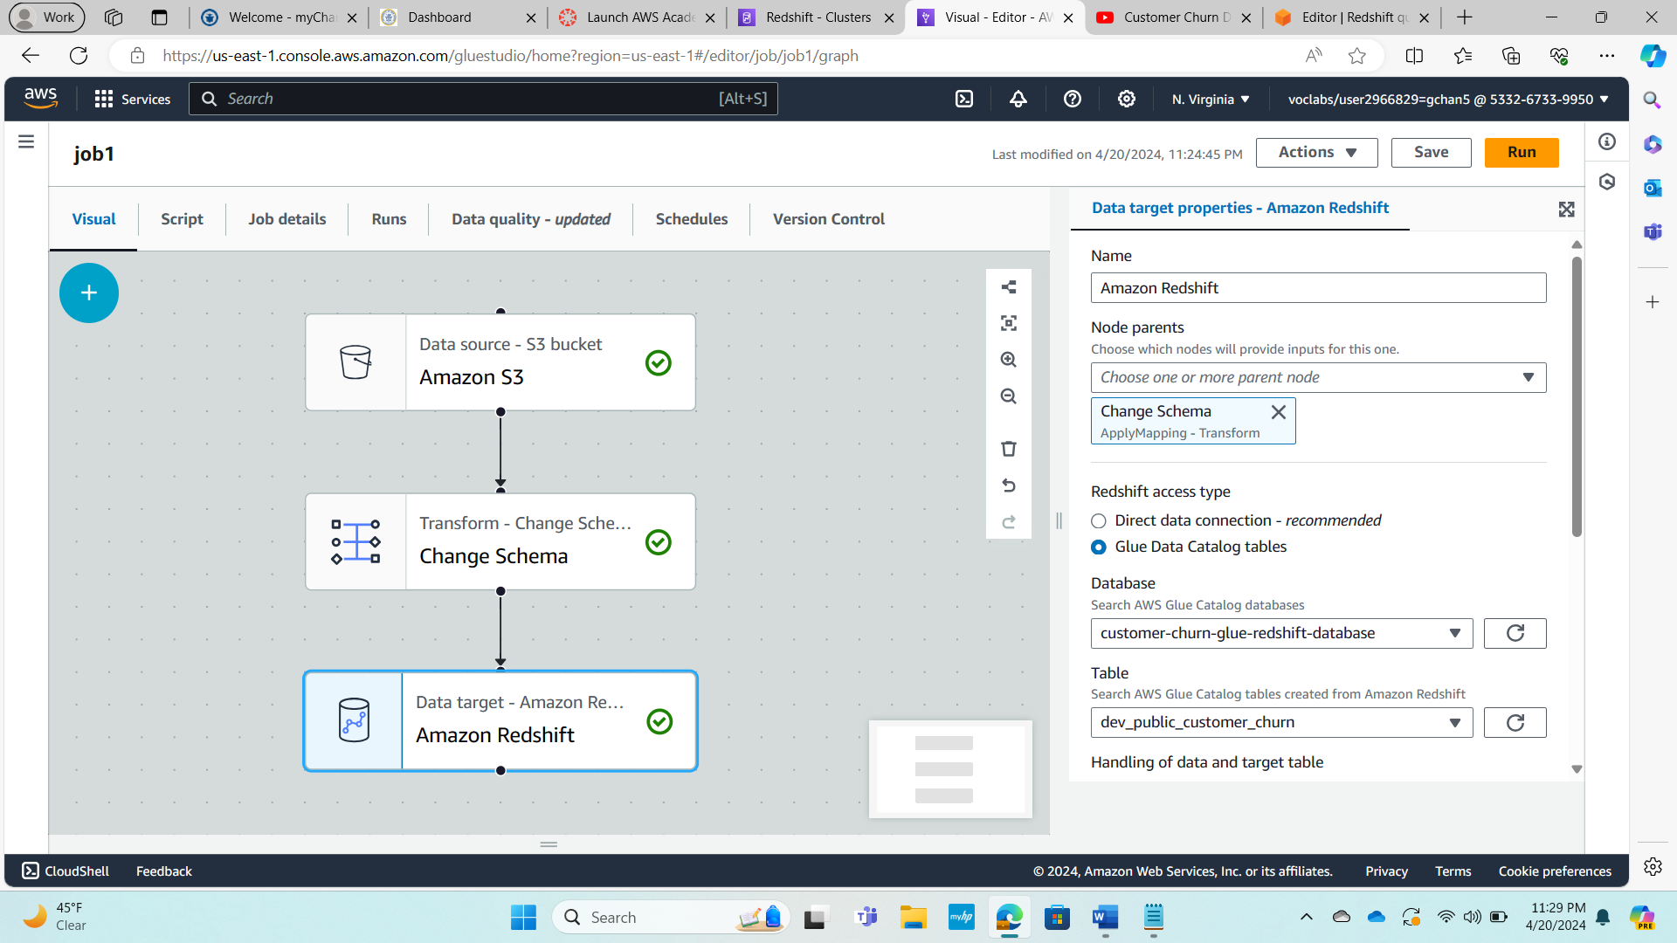
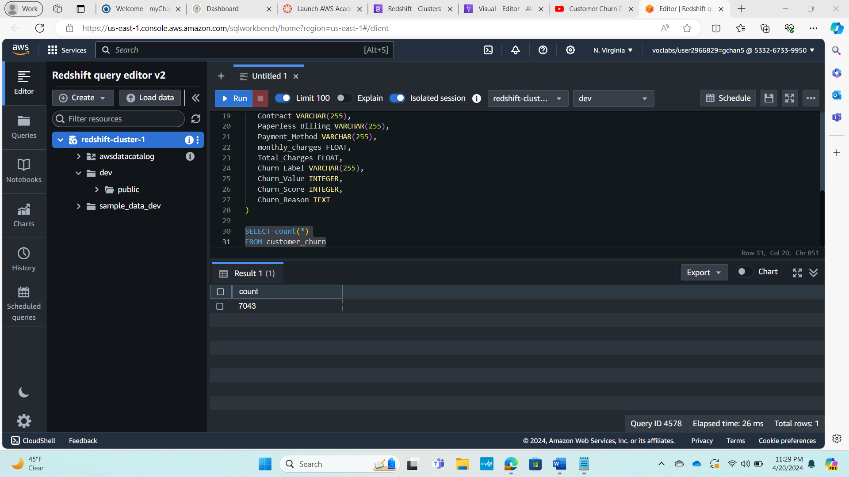

Slide 16
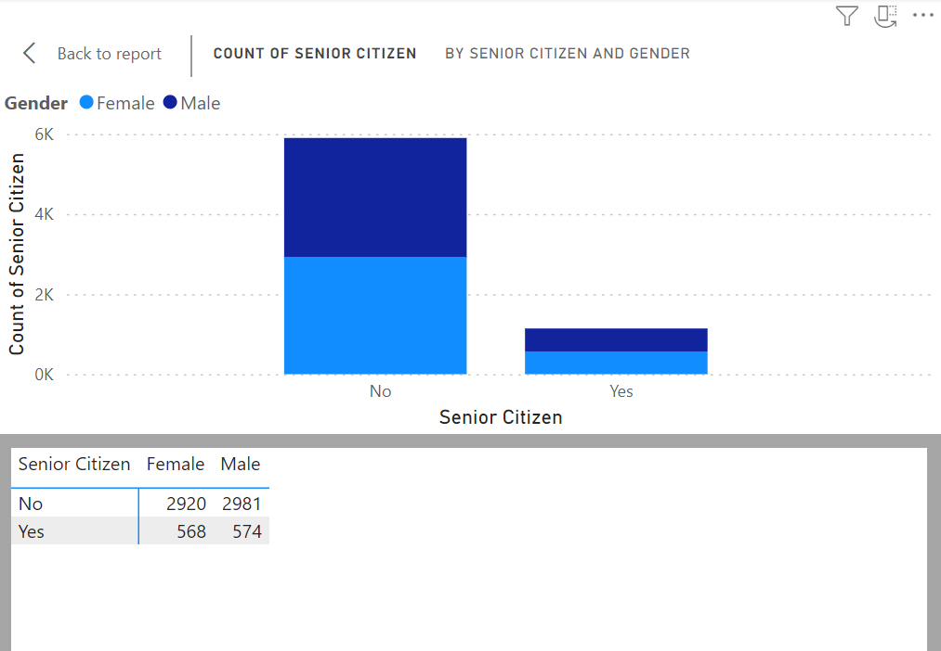
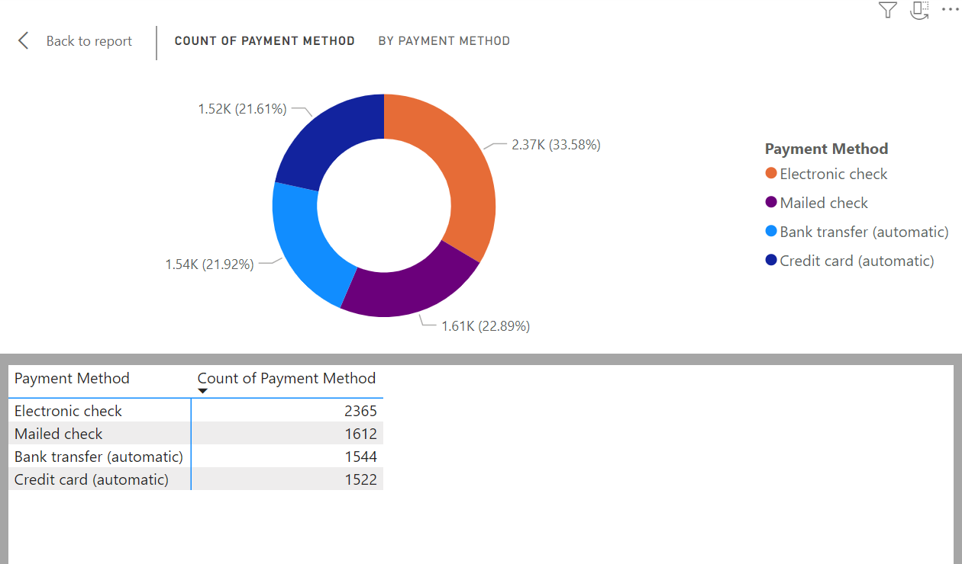
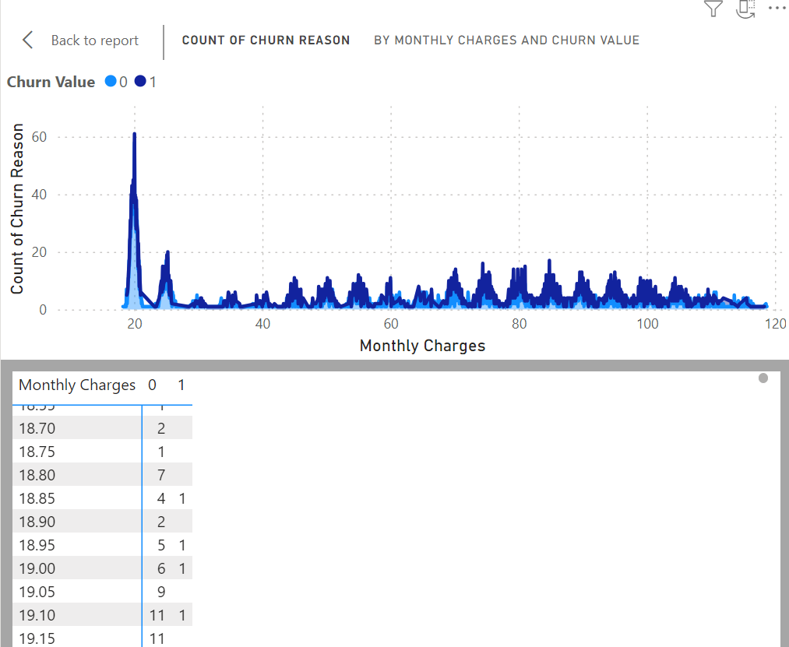
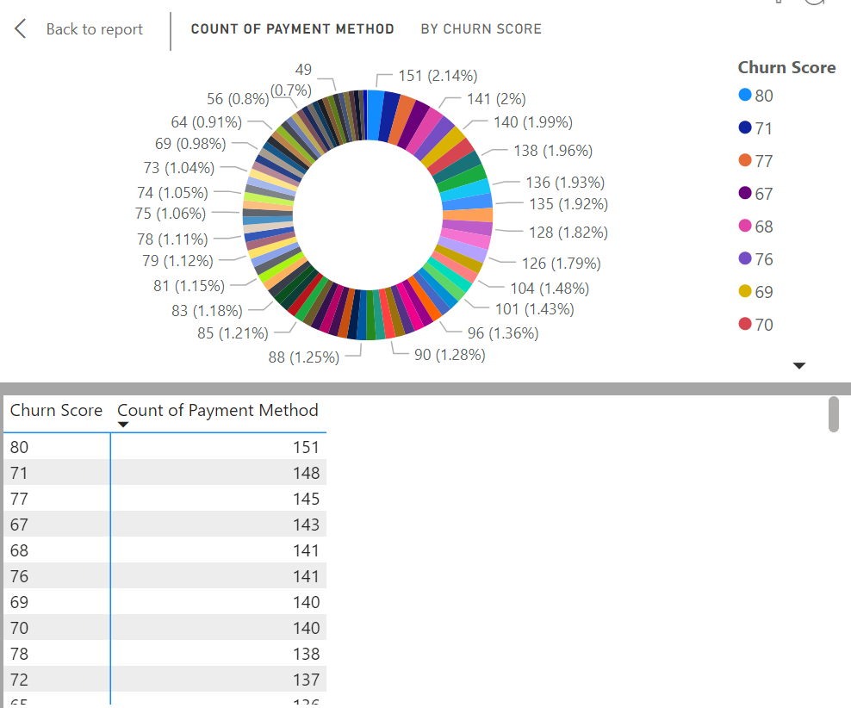

Slide 17
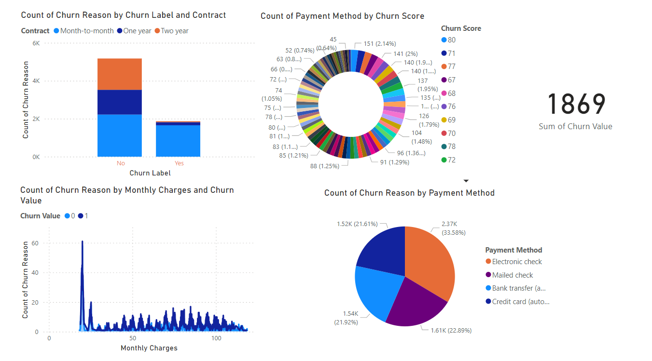
The Visualizations in Customer Attrition Analysis using PowerBI is above.
Here in this project, after completing the whole ETL process using Amazon RedShift we will be loading the data into PowerBI for output visualization.

Slide 18
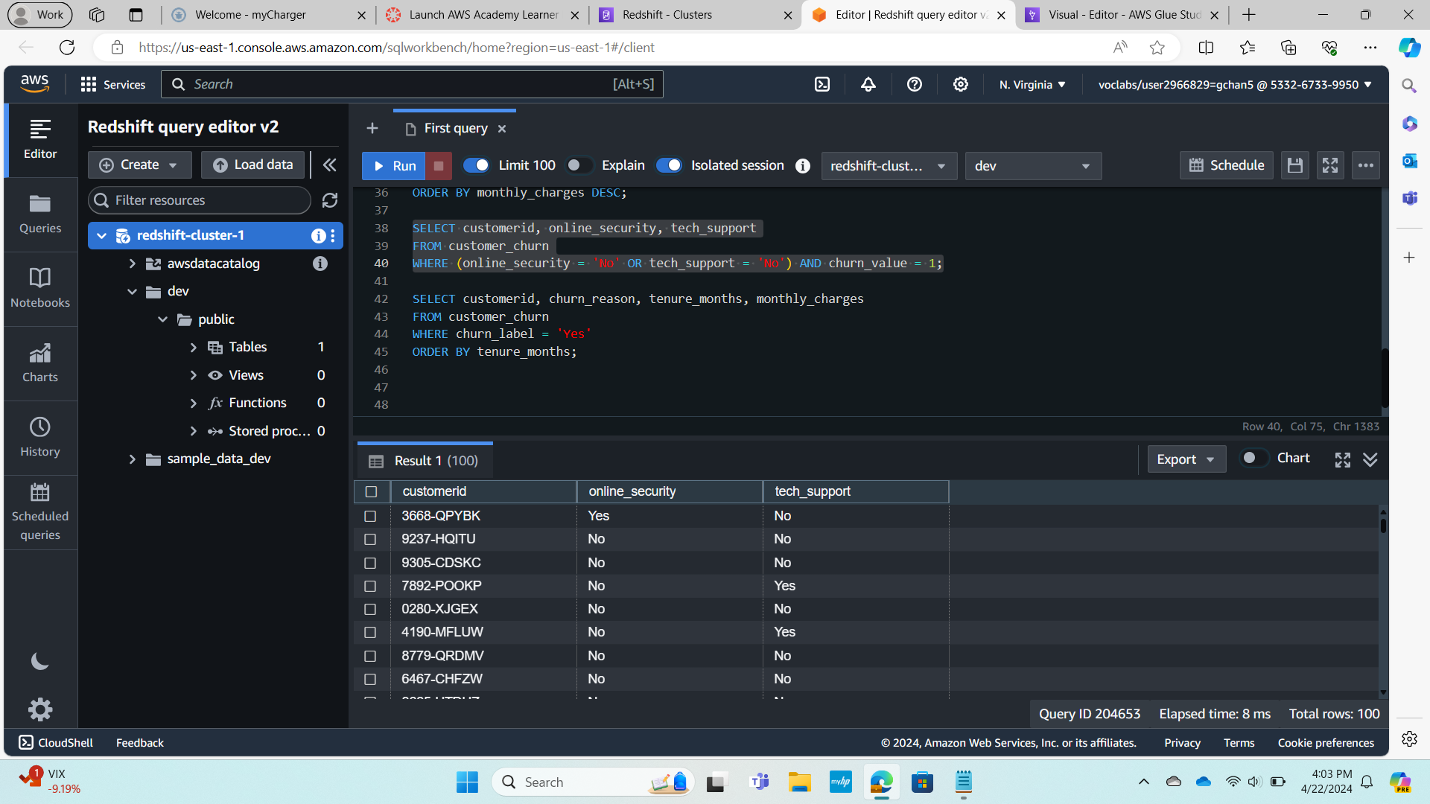
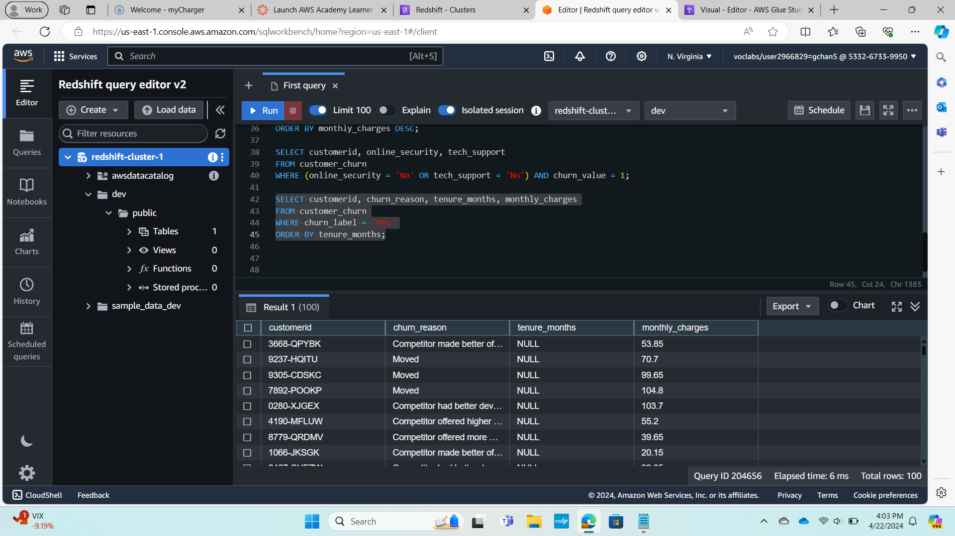
Queries for Business Questions proposed:

Slide 19
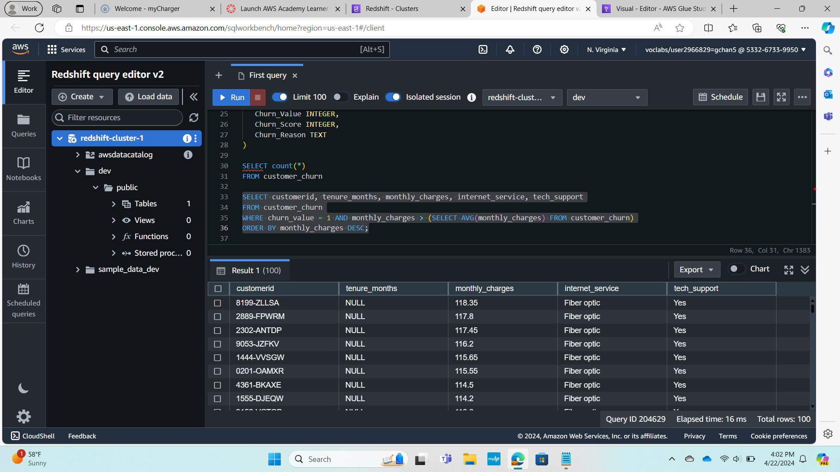

Slide 20
Conclusion:
By reducing acquisition costs and boosting marketing effectiveness, customer churn analysis helps lay the groundwork for future marketing research and initiatives. In order to keep consumers interested and devoted over time, customer churn research creates new chances for cross-selling and upselling as well as one of the foundations for customer-driven product development.

Slide 21


